Slide 1
Musical Cubes
“The Three Sided Die”
Eli Doggart, Owen Krause, Matthew Sweeney

Slide 2

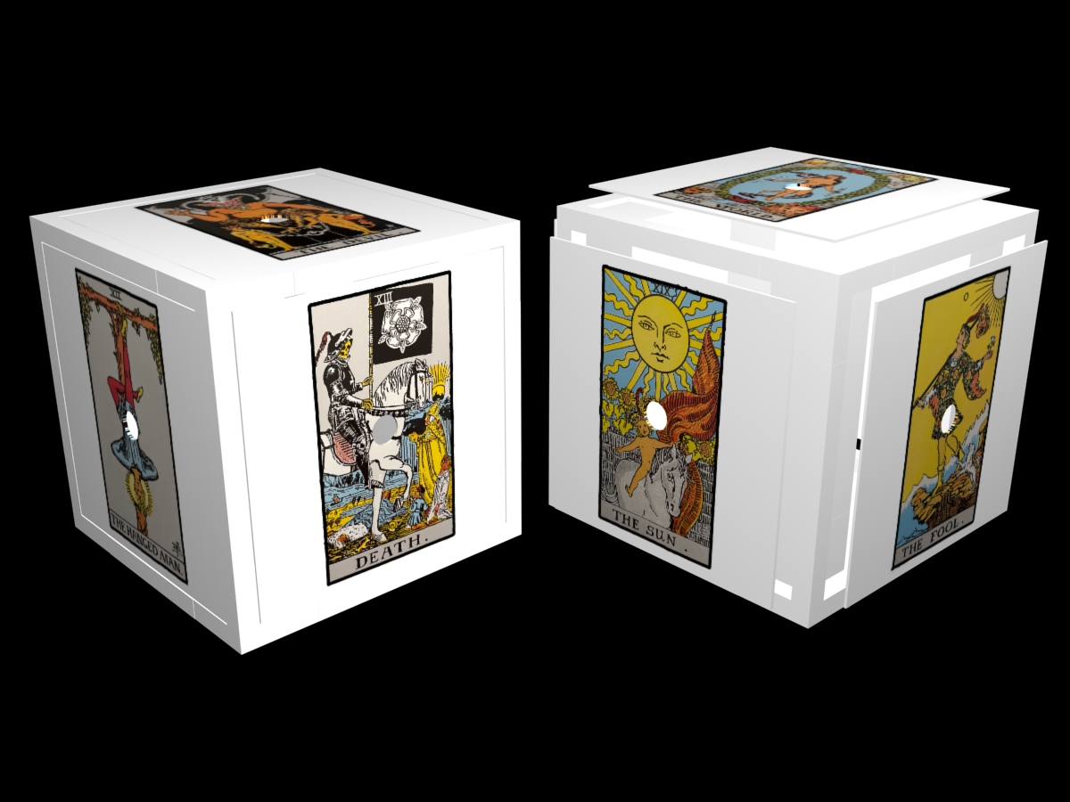
Goal
Design and fabricate a cube that connects to a computer and based on the side it lands on when rolled commands a musical result. Using a combination of BLE and python scripts that interact with the midi bus

Slide 3

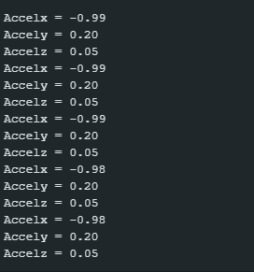
Accomplishments
Scrapped midi device idea. We are now using the cube simply as a sensor and nothing else. Just hands back acceleration data
Wrote arduino code for the cube to advertise the acceleration values for x, y, and z
Found a way to use python scripts to send data to the midi bus

Slide 4
Challenges
Finding a new way to operate the cubes without it necessarily being a midi device.
The python scripts aren’t done yet.
BLE is still lil finicky, works well enough now though.
Need to check the data structures in the arduino code as the hex value are more or less correct.

